Slide 1




Mammogram Mass Prediction

Slide 2
Introduction
Breast cancer is the most common cancer diagnosed in women in several countries (Ref American Cancer Society). It is a cancer that forms in the cells of the breasts. Mammography screening for breast cancer is at present the most effective method in reducing breast cancer mortality. A lot of unnecessary surgery arises from false positives arising from mammogram results. This capstone aim to apply several supervised machine learning techniques to identify if a mass lesion is malign or benign. It will help any stakeholder (radiologist, doctor, patient) build a better way to interpret the mammogram results and improve a lot of lives.

Slide 3
Slide 3
Data acquisition and cleaning
The UCI repository made public a dataset called mammographic masses. (source: https://archive.ics.uci.edu/ml/datasets/Mammographic+Mass) It contains 961 instances of masses detected in mammograms, with the following attributes:
BI-RADS assessment of the breast density: 1 to 5 (ordinal).This attribute show how confident the severity classification is; it is not a "predictive" attribute
Age: patient's age in years (integer)
Shape: mass shape: round=1 oval=2 lobular=3 irregular=4 (nominal)
Margin: mass margin: circumscribed=1 microlobulated=2 obscured=3 ill-defined=4 spiculated=5 (nominal)
Density: mass density high=1 iso=2 low=3 fat-containing=4 (ordinal)
Severity: benign=0 or malignant=1 (binominal) Severity is the classification that our ML will attempt to predict based on those attributes above.

Slide 4
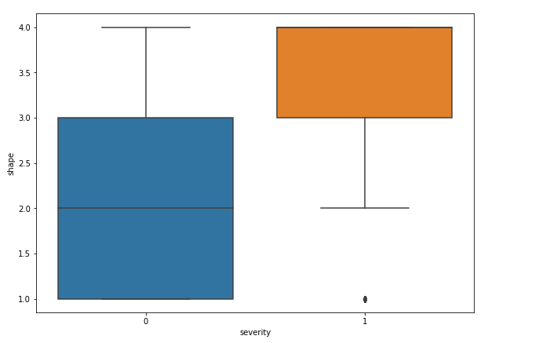
Severity by shape of breast
The mean of the severity by shape : 3.739454
Notes:
When conducting research, it is easy to go to one source: Wikipedia. However, you need to include a variety of sources in your research. Consider the following sources:
Who can I interview to get more information on the topic?
Is the topic current and will it be relevant to my audience?
What articles, blogs, and magazines may have something related to my topic?
Is there a YouTube video on the topic? If so, what is it about?
What images can I find related to the topic?

Slide 5
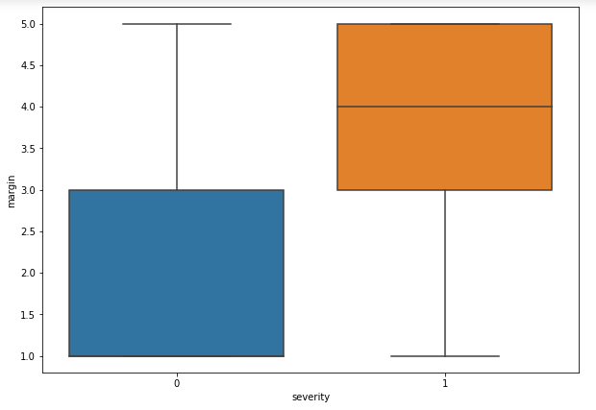
Severity by margin of breast
The mean of the severity by margin : 3.503722
Notes:
When conducting research, it is easy to go to one source: Wikipedia. However, you need to include a variety of sources in your research. Consider the following sources:
Who can I interview to get more information on the topic?
Is the topic current and will it be relevant to my audience?
What articles, blogs, and magazines may have something related to my topic?
Is there a YouTube video on the topic? If so, what is it about?
What images can I find related to the topic?

Slide 6
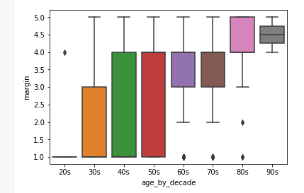
Severity by margin by age
Notes:
When conducting research, it is easy to go to one source: Wikipedia. However, you need to include a variety of sources in your research. Consider the following sources:
Who can I interview to get more information on the topic?
Is the topic current and will it be relevant to my audience?
What articles, blogs, and magazines may have something related to my topic?
Is there a YouTube video on the topic? If so, what is it about?
What images can I find related to the topic?

Slide 7
Severity by margin by age
Notes:
When conducting research, it is easy to go to one source: Wikipedia. However, you need to include a variety of sources in your research. Consider the following sources:
Who can I interview to get more information on the topic?
Is the topic current and will it be relevant to my audience?
What articles, blogs, and magazines may have something related to my topic?
Is there a YouTube video on the topic? If so, what is it about?
What images can I find related to the topic?

Slide 8
Pattern and detail
The analysis of the graphic above and the interpretation of the data show the age bracket where breast cancer severity start increasing is between 40 and 60.
Most women who has severity of breast cancer are in their age bracket [60, 80[.
It shows as well some outliers: 1 Woman in age bracket of 20 who has breast cancer of severity 4.
3 women in age bracket of 90 who has breast cancer of severity 4.
It shows women in [70, 80] who don’t present any sign of breast cancer.
Severity=1 | Total
[20,40[ | 14
[40,60[ | 164
[60,80[ | 226
[80,100[ | 36
Grand Total | 440
Notes:
Once you find your sources, you will want to evaluate your sources using the following questions:
Author:
Who is the author?
Why should I believe what he or she has to say on the topic?
Is the author seen as an expert on the topic? How do you know?
Current:
How current is the information in the source?
When was the source published?
Is the information out-of-date?
Accuracy:
Is the content accurate?
Is the information presented objectively? Do they share the pros and cons?

Slide 9
Pattern and detail
Total by severity
Severity | Age | Total
0 | [20,100[ | 516
1 | [20,100[ | 440
1 | Age is null | 5
Notes:
Once you find your sources, you will want to evaluate your sources using the following questions:
Author:
Who is the author?
Why should I believe what he or she has to say on the topic?
Is the author seen as an expert on the topic? How do you know?
Current:
How current is the information in the source?
When was the source published?
Is the information out-of-date?
Accuracy:
Is the content accurate?
Is the information presented objectively? Do they share the pros and cons?

Slide 10
Pattern and detail
Outlier
Age | Total with severity
28 | 1
]30,40[ | 13
[90,99[ | 3
Notes:
Once you find your sources, you will want to evaluate your sources using the following questions:
Author:
Who is the author?
Why should I believe what he or she has to say on the topic?
Is the author seen as an expert on the topic? How do you know?
Current:
How current is the information in the source?
When was the source published?
Is the information out-of-date?
Accuracy:
Is the content accurate?
Is the information presented objectively? Do they share the pros and cons?

Slide 11
Results
Algorithm | Accuracy
Logistic Regression | 0.80735
KNN | 0.8036 for k= 60 until 100
Naïve Baises | 0.7844
DecisionTrees | 0.7373 for k=10
SVM with kernel (Linear,poly,rbf) | Linear=0.7964 | RBF=0.8062 | Sigmoid=0.7351 | Poly=0.7927
RandomForestClassifier | 0.7528 for n_Estimator=10

Slide 12
Conclusion and Discussion
This study help to answer to the business problem. It give to stakeholder a different way to view the data, they can easily visualize the relationship between the attributes.
The relationship among between different attribute provided in the dataset have been analyzed.
The feature BI-RAID have been excluded and the feature age,shape,margin,density have been selected among important feature to predict the breast cancer.
After applying several ML classification algorithm, DecisionTree ,SVM with sigmoid kernel give the worst performance. LogisticRegression and SVM with rbf kernel give better results.We can conclude the accuracy of the result can help any stakeholder (radiologist, doctor, patient) to take decision quickly and build a better way to interpret the mammogram results and improve a lot of lives. However other studies to predict breast cancer must be done using the breast images.
.

Slide 13
Mammogram Mass Prediction
Notes:
You can use this slide as your opening or closing slide. Should you choose to use it as a closing, make sure you review the main points of your presentation. One creative way to do that is by adding animations to the various graphics on a slide. This slide has 4 different graphics, and, when you view the slideshow, you will see that you can click to reveal the next graphic. Similarly, as you review the main topics in your presentation, you may want each point to show up when you are addressing that topic.
Add animation to images and graphics:
Select your image or graphic.
Click on the Animations tab.
Choose from the options. The animation for this slide is “Split”. The drop-down menu in the Animation section gives even more animations you can use.
If you have multiple graphics or images, you will see a number appear next to it that notes the order of the animations.
Note: You will want to choose the animations carefully. You do not want to make your audience dizzy from your presentation.

